Slide 1
Key lessons from the 'Burgberg Zschaitz' habitat bank in Saxony Using government metrics and ensuring permanent protection for biodiversity offsets under the German impact mitigation regulation
“TO NO NET LOSS OF BIODIVERSITY AND BEYOND”, 3-4 June, 2014, Zoological Society of London, Regent’s Park
Marianne Darbi, Prof. Wolfgang Wende (IOER)
Jörg Voss (Sächsische Ökoflächenagentur)

Slide 2
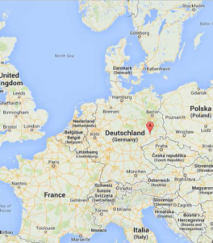
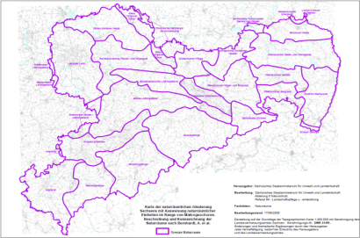
Clear regulation and policy guidance
Good experience with mandatory system as a prerequisite for success
Installation of the habitat bank and approval of credits by the competent Nature Conservation Authority, Compensation land register
Clear and consistent loss-gain-calculations and metrics: biotope value based procedure
Spatial and functional relation of impact and offset: compensation within the same Natural Landscape Unit

Slide 3
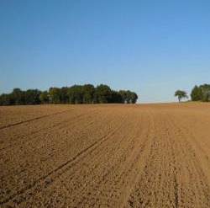
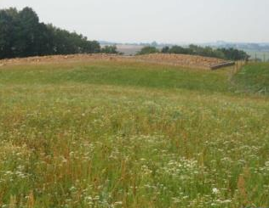
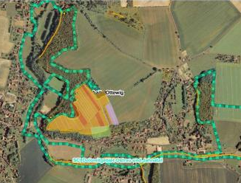
Active land management for higher nature conservation outcomes
secure land with a high nature conservation value or potential through land purchase, change or consolidation (land consolidation enables quick and easy land acquisition without extra costs)
Implementation of larger, complex and high quality measures adds to reaching state-wide nature conservation goals and strengthen biotope networks and is more cost-efficient
Compensation is best implemented in the “normal landscape”, not in protected areas (where potential for enhancement is low and costs are high) → Don’t touch the Habitats Directive!
before after

Slide 4
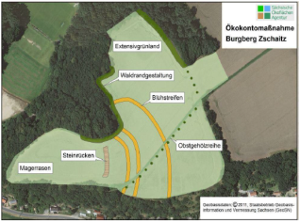
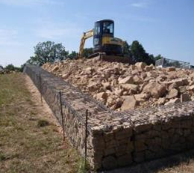
Sound business and full costing
Stable, independent and not profit-oriented compensation services provider enables the maintenance and safeguarding of the measures in perpetuity
Calculating a price for the single credit – full costing (“Vollkostenkalkulation”) includes all costs from planning of goals and measures over and land acquisition and project implementation to maintenance and monitoring, including parameters such as securities, risk and bridge financing
Costing is a process that builds on balancing target values and actual values: a cost estimate at the beginning is quarterly compared with actual used resources → Price for the single credit adjusts over time to the actual costs

Slide 5
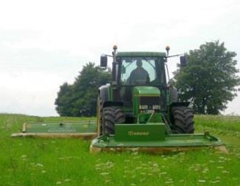
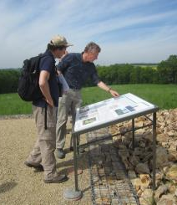
Strong regional cooperation
Landowners and Farmers: compensation through Land Use Contracts reduces consumption of farming land for offsets
Authorities: approval and agreement through the whole process
Public: acceptance through clear nature conservation goals including socioecological aspects
Federal Association of Compensation Agencies: common quality standards

Slide 6
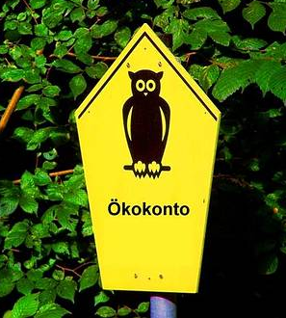
Contact
Leibniz Institute of Ecological Urban and Regional development (IOER)
Marianne Darbi
Fon: 0351 4679 223
Fax : 0351 4679 212
E-Mail: M.Darbi@ioer.de
Sächsische Ökoflächen-Agentur
Jörg Voss
Fon: 03521 4690 29
E-Mail: joerg.voss@sls-sachsen.de

